Slide 1
BIODIVERSITY

Slide 2
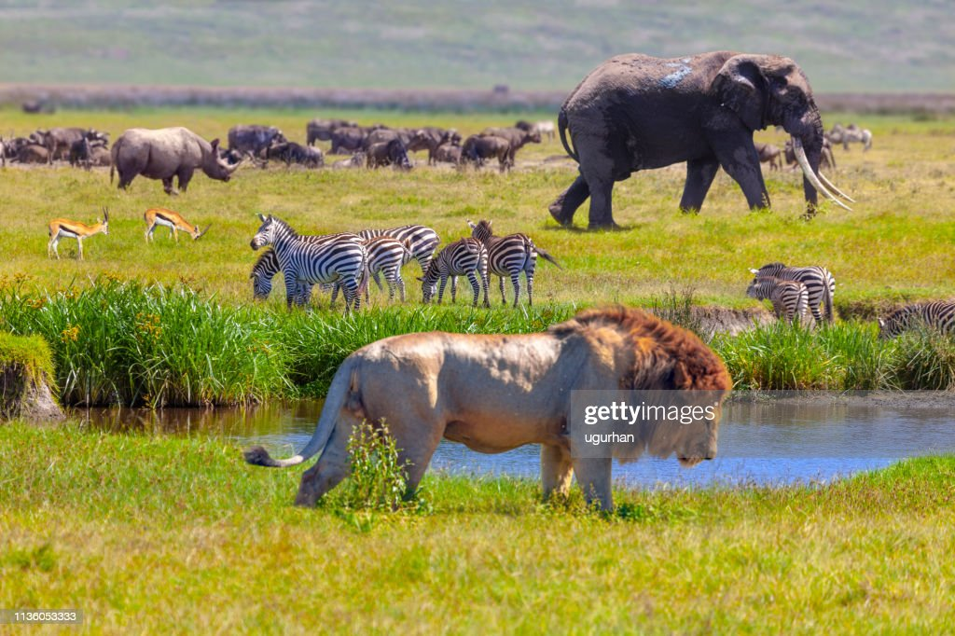

Slide 3
Biodiversity Definition
“Biodiversity is the variation among living organisms from different sources including terrestrial, marine and desert ecosystems, and the ecological complexes of which they are a part.”
What is Biodiversity?
Biodiversity describes the richness and variety of life on earth. It is the most complex and important feature of our planet. Without biodiversity, life would not sustain.
The term biodiversity was coined in 1985. It is important in natural as well as artificial ecosystems. It deals with nature’s variety, the biosphere. It refers to variabilities among plants, animals and microorganism species.
Biodiversity includes the number of different organisms and their relative frequencies in an ecosystem. It also reflects the organization of organisms at different levels.
Biodiversity holds ecological and economic significance. It provides us with nourishment, housing, fuel, clothing and several other resources. It also extracts monetary benefits through tourism. Therefore, it is very important to have a good knowledge of biodiversity for a sustainable livelihood

Slide 4
What are the major causes of loss of biodiversity?
Climate change.
Pollution.
Destruction of habitats.
Invasive alien species.
Overexploitation of the natural environment.

Slide 5
Importance of Biodiversity
Biodiversity and its maintenance are very important for sustaining life on earth. A few of the reasons explaining the importance of biodiversity are:
Ecological Stability
Every species has a specific role in an ecosystem. They capture and store energy and also produce and decompose organic matter. The ecosystem supports the services without which humans cannot survive. A diverse ecosystem is more productive and can withstand environmental stress.
Economic Importance
Biodiversity is a reservoir of resources for the manufacture of food, cosmetic products and pharmaceuticals.
Crops livestock, fishery, and forests are a rich sources of food.
Wild plants such as Cinchona and Foxglove plant are used for medicinal purposes.
Wood, fibres, perfumes, lubricants, rubber, resins, poison and cork are all derived from different plant species.
The national parks and sanctuaries are a source of tourism. They are a source of beauty and joy for many people.
Ethical Importance
All species have a right to exist. Humans should not cause their voluntary extinction. Biodiversity preserves different cultures and spiritual heritage. Therefore, it is very important to conserve biodiversity.

Slide 6
Conservation of Biodiversity:
We know that our planet is home to various plants and animal species, including human beings. Healthy biodiversity constantly forms a healthy ecosystem. But in the modern era, due to reduction of space, loss of habitat, hunting of animals, deforestation, climate change, pollution, and over-exploitation by humans, the ecosystem is under threat. These factors are the reason for the extinction of many living species from earth. As the human population derives many benefits from biodiversity, it is our moral duty to preserve biodiversity and create a healthy ecosystem for future generations. Conservation of biodiversity is significant for a healthy and functional ecosystem.

